Slide 1
Rajasthan Digifest Hackathon 5.0
Project Name: Checking vulnerabilities in official(government websites)

Slide 2
Aim: To detect the faults in government websites.
Rajasthan has a population of: 74.888 Million
As per the #humsabdigital , the amount of bugs available in the government websites are high.
The risk they posses , makes the hackers easy to copy, change and delete the confidential data like Aadhar Details, Bank account details etc.
This can effect us a lot in all the factors, economy, health and much more.
The 21st century is the century of data & information, the one who has it is the master i.e. USA

Slide 3
Introduction
Rajasthan has a population of: 74.888 Million
As per the #humsabdigital , the amount of bugs available in the government websites are high.
The risk they posses , makes the hackers easy to copy, change and delete the confidential data like Aadhar Details, Bank account details etc.
This can effect us a lot in all the factors, economy, health and much more.
The 21st century is the century of data & information, the one who has it is the master i.e. USA

Slide 4
How is it done
We used the specialized tools to attack, and test the website of government.
This effort was strictly made in good moto. We ensure that we didn’t any of the user data in any means.
OS used: KALI LINUX 18.2
Estimated Time: 25 mins(upto 22% completion).

Slide 5
Tools used 1.VEGA
Vega is a free and open source scanner and testing platform to test the security of web applications.
Vega can help you find and validate SQL Injection, Cross-Site Scripting(XSS), inadvertently disclosed sensitive information, and other vulnerabilities. It is written
in Java, GUI based, and runs on Linux, OS X, and Windows.
Vega includes an automated scanner for quick tests and an intercepting proxy for tactical inspection. Vega can be extended using a powerful API in the language of the web: JavaScript

Slide 6
2.Sparta
SPARTA is a python GUI application that simplifies network infrastructure penetration testing by aiding the penetration tester in the scanning and enumeration phase. It allows the tester to save time by having point-and-click access to their toolkit and by displaying all tool output in a convenient way. If less time is spent setting up commands and tools, more time can be spent focusing on analysing results.

Slide 7
3.Recon-ng
Recon-ng is a full-featured Web Reconnaissance framework written in Python. Complete with independent modules, database interaction, built in convenience functions, interactive help, and command completion, Recon-ng provides a powerful environment in which open source web-based reconnaissance can be conducted quickly and thoroughly.

Slide 8
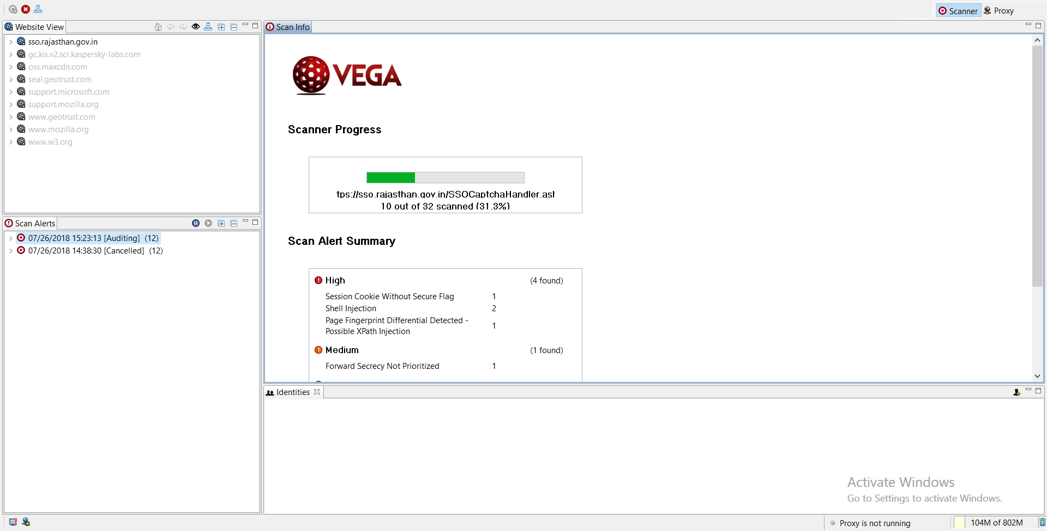
Websites tested 1.Rajasthan Digifest

Slide 9
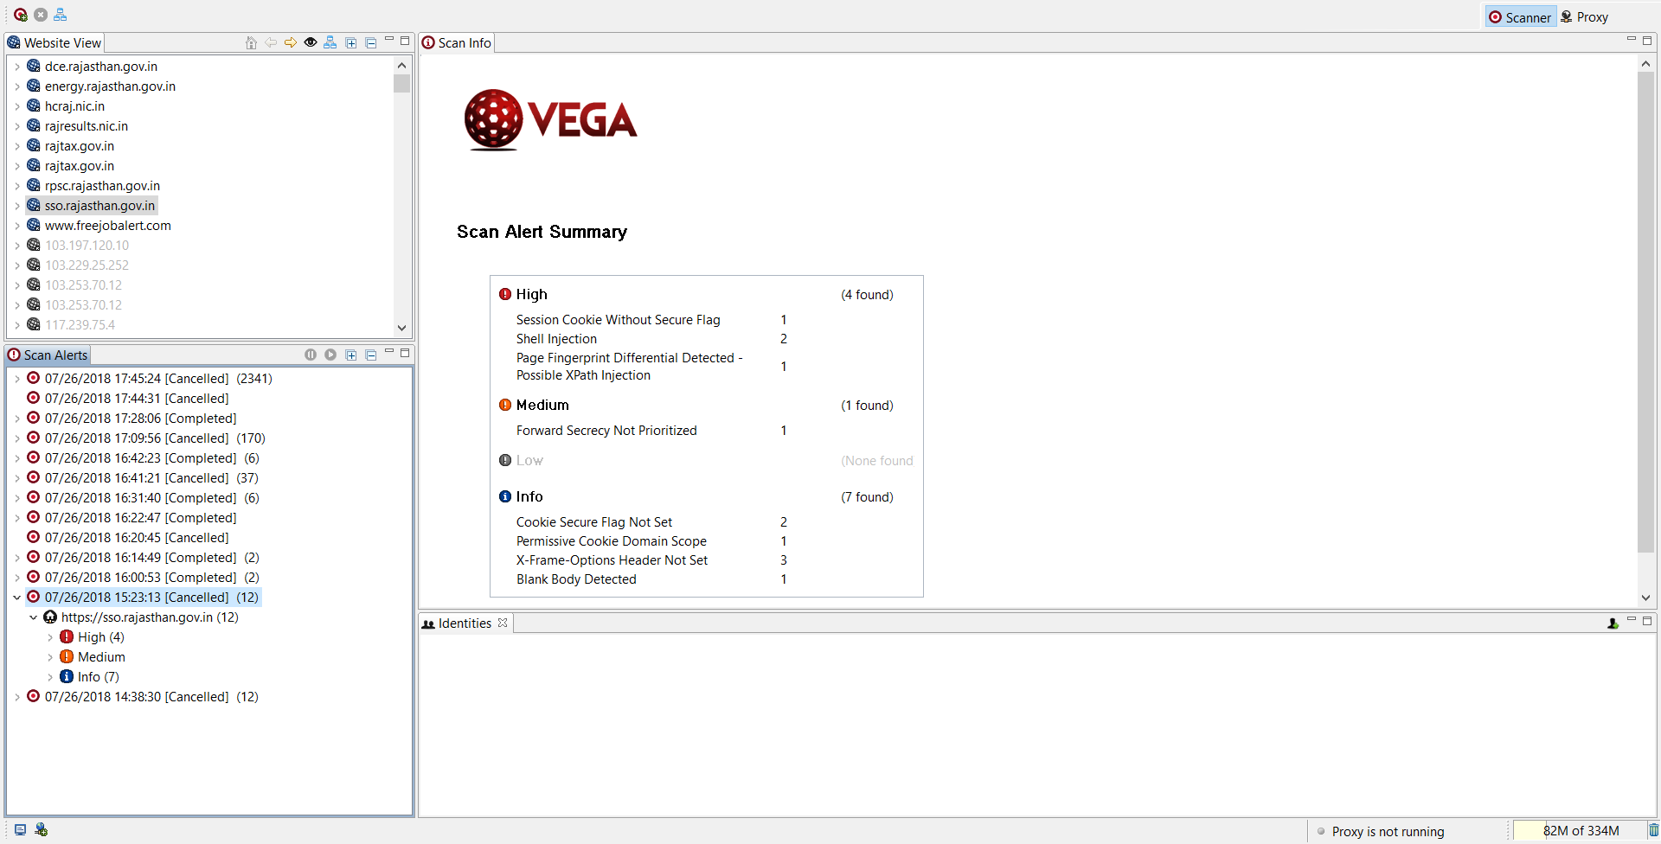

Slide 10
List of Threats Found
Following is a list of threats in website:
High: cookie flag, Shell Injection, XPath Injection
Medium : 0
Low : 0

Slide 11
Possible preventions
The user data the website stores is more than risky in today’s world ever thought, we can change the infrastructure, server configs.
Implementing Blockchains for storing and generating user data as it is more secure.
Maintaining the websites by the hand of government Analysts and experts, the dedicated team appointed by Government itself, not some third party or contract company

Slide 12
THANK YOU
An effort by:-
Sumit Patil: SUMITCPATIL26852244
Rahul Chopade: RAHUL.CHOPADE
Ajay Pawar: PAWARAJAYAN41

